Slide 1
Slam is a State Estimation Problem

Slide 2
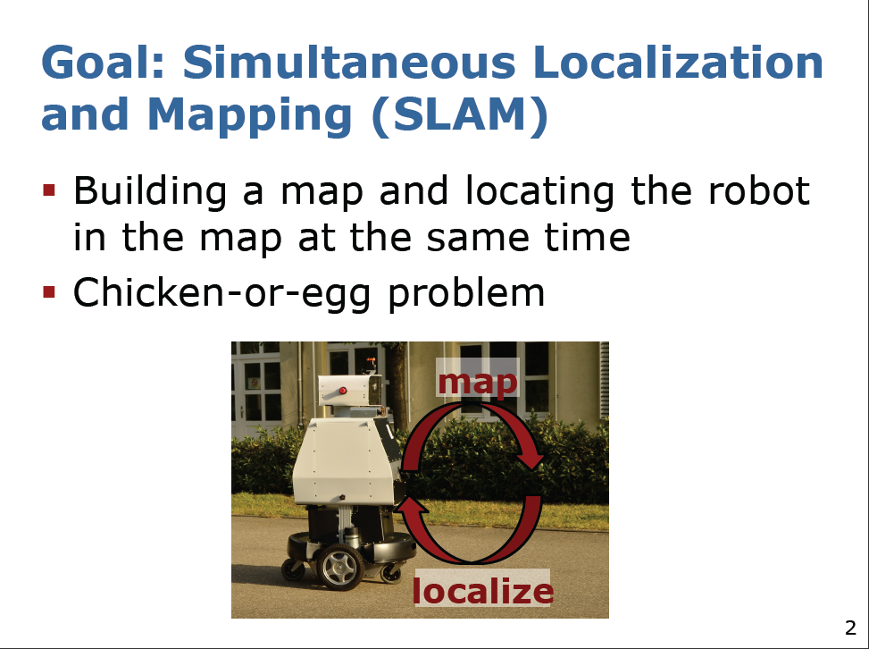

Slide 3
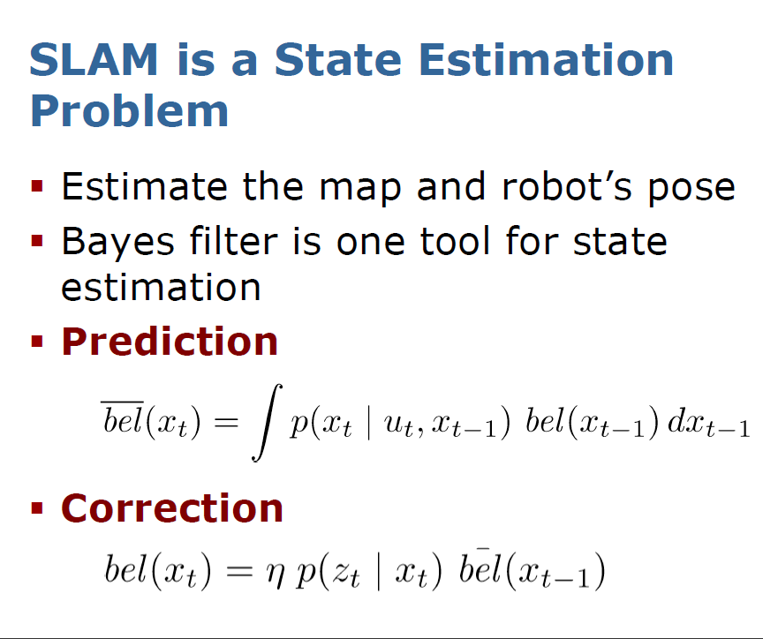
Predicted belief
corrected belief

Slide 4
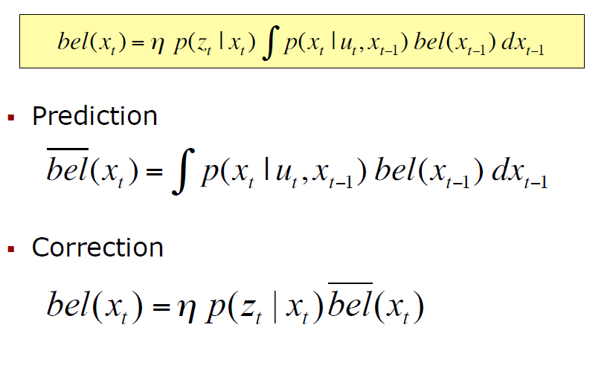
Bayes Filter Reminder

Slide 5
Gaussians

Slide 6
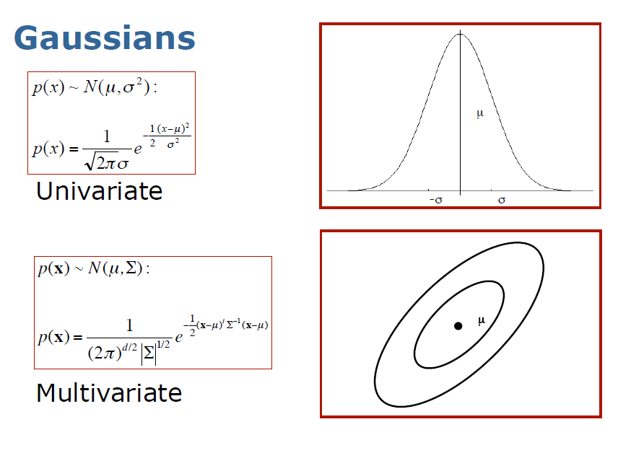
Standard deviation
Covariance matrix

Slide 7
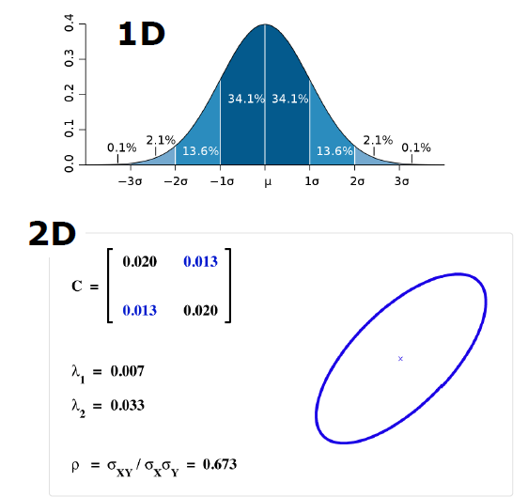
Gaussians in one and two dimensions
One standard deviation
two standard deviations

Slide 8
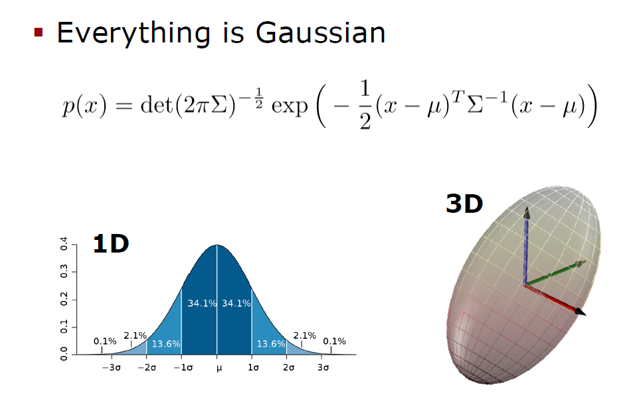
Multivariate probability
Gaussians in three dimensions

Slide 9
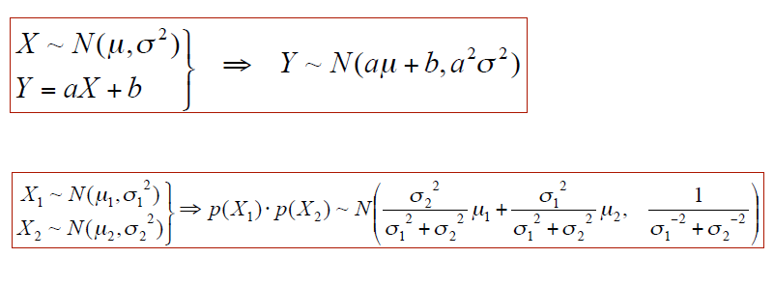
Properties of Gaussians for Univariate case
Mean on output of linear system
Standard deviation on output of linear system
Linear system
For two-dimensional system:

Slide 10
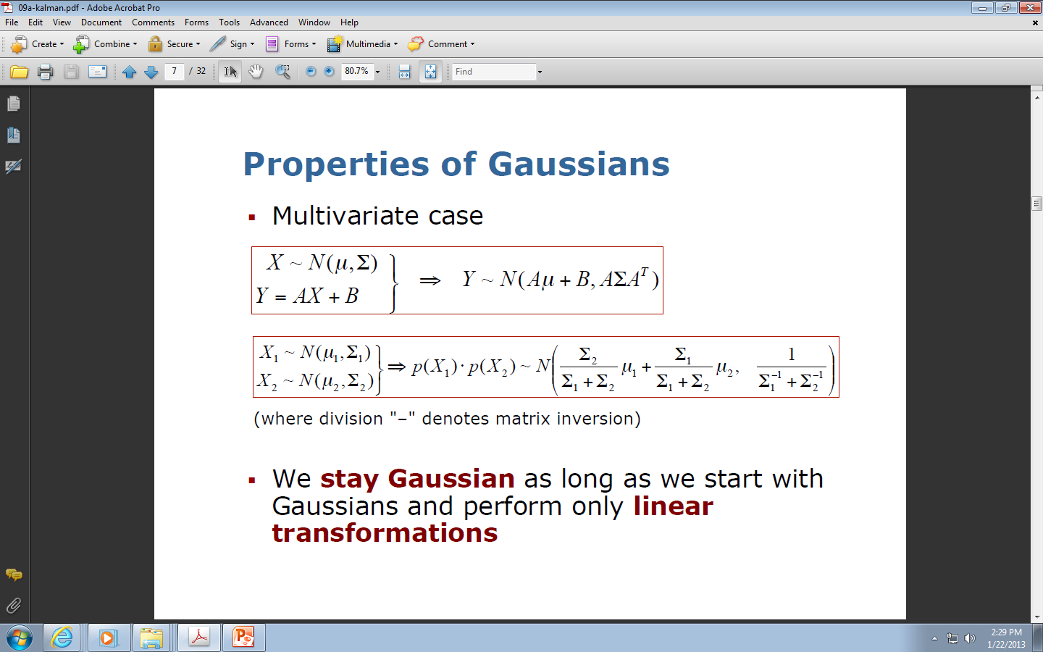
Properties of Gaussians
Properties of Gaussians for Multivariate case
From previous slide

Slide 11
Properties of Gaussians
Important Property of all these methods

Slide 12
Discrete Kalman Filters

Slide 13
Kalman Filter background
Kalman Filter is a Bayes Filter
Kalman Filter uses Gaussians
Estimator for the linear Gaussian case
Optimal solution for linear models and Gaussian distributions
Developed in late 1950’s
Most relevant Bayes filter variant in practice
Applications in econcomics, weather forecasting, satellite navigations, GPS, robotics, robot vision and many other
Kalman filter is just few matrix operations such as multiplication.

Slide 14
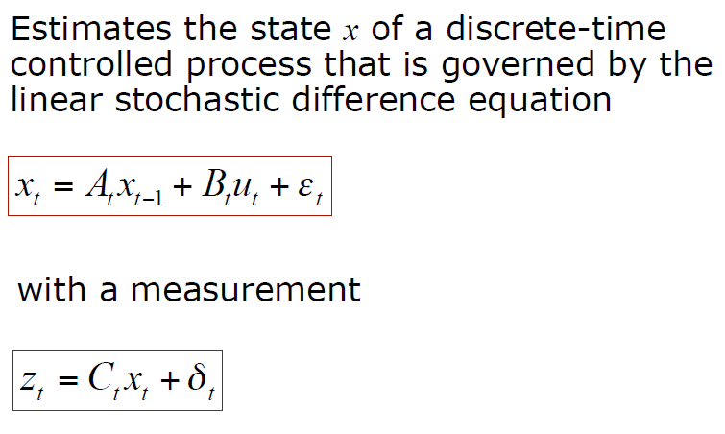
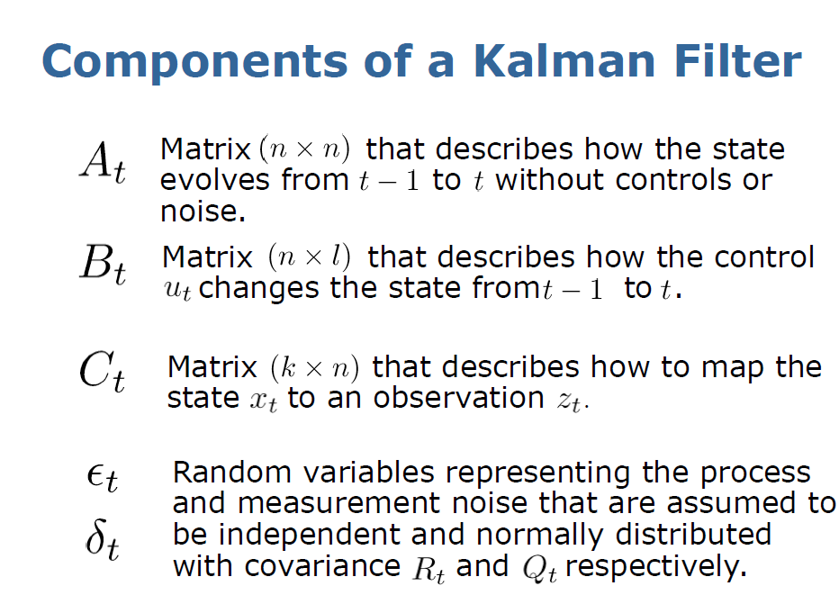
Discrete Kalman Filter

Slide 15
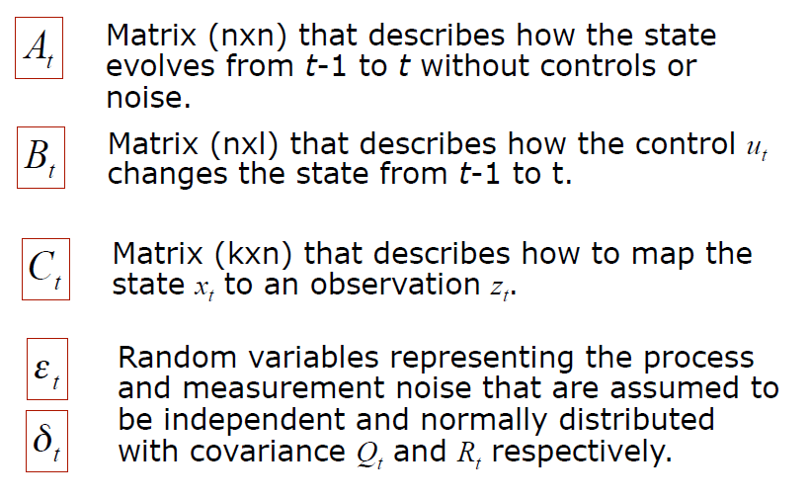
Components of a Kalman Filter

Slide 16
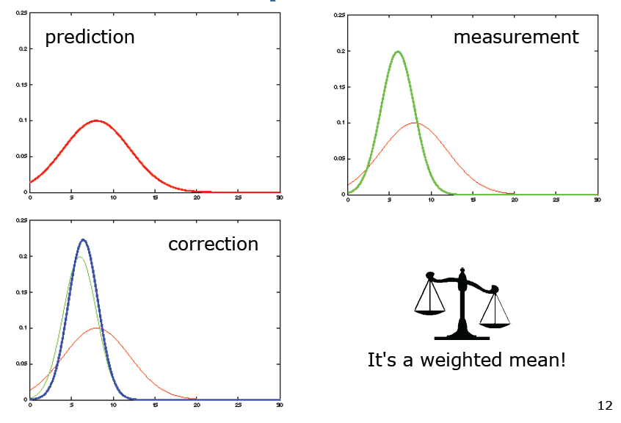
Example of Kalman Filter Updates in one dimension
Kalman Filter calculates a weighted mean value!

Slide 17
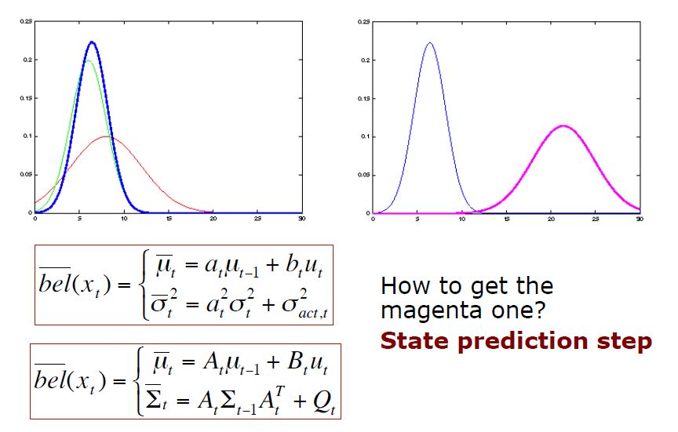
Kalman Filter Updates in 1D: PREDICTION
Single dimension
Again generalization to many dimensions here
Matrices in multi-dimensions

Slide 18
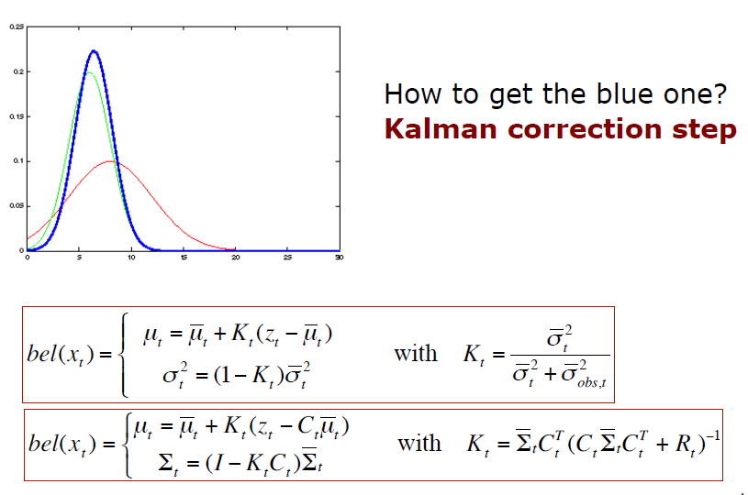
Kalman Filter Updates in 1D: CORRECTION
Variant single variable
Generalization: Variant of multiple variables
matrix

Slide 19
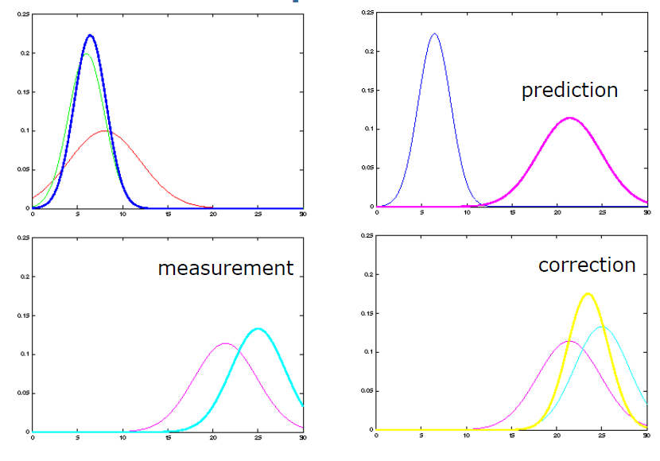
Kalman Filter Updates

Slide 20
Linear Gaussian Systems

Slide 21
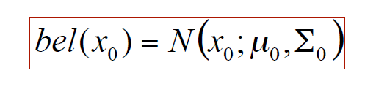
Linear Gaussian Systems: Initialization
Initial belief has a normal distribution:

Slide 22
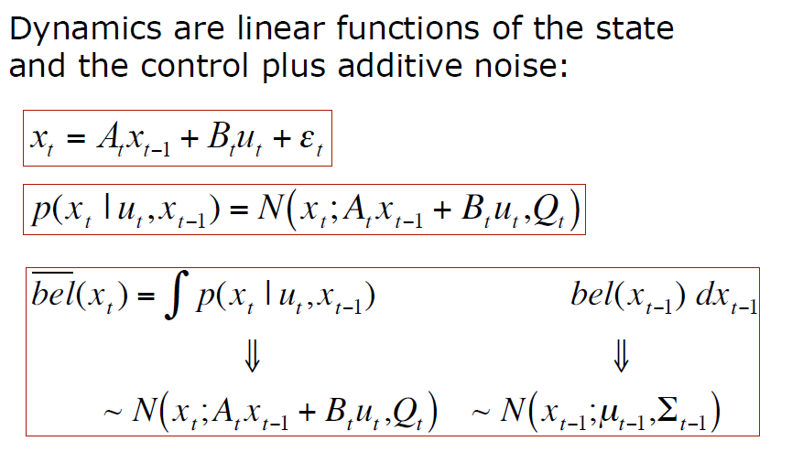
Linear Gaussian Systems: Dynamics
Gaussian

Slide 23
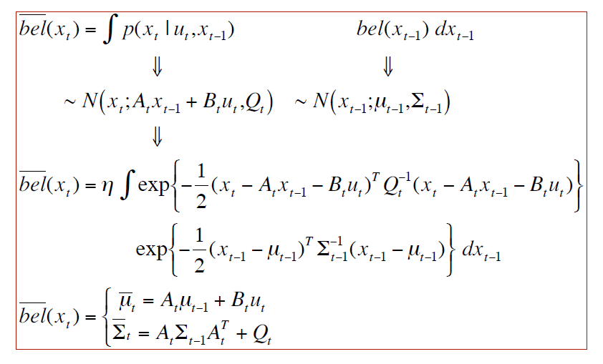
Linear Gaussian Systems: Dynamics
From previous slide
Linear, gaussian

Slide 24
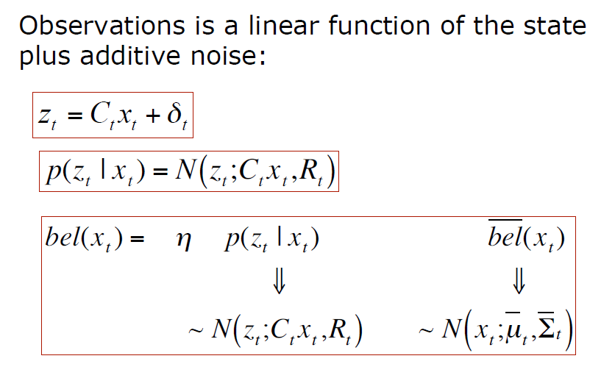
Linear Gaussian Systems: Observations
R = correction

Slide 25
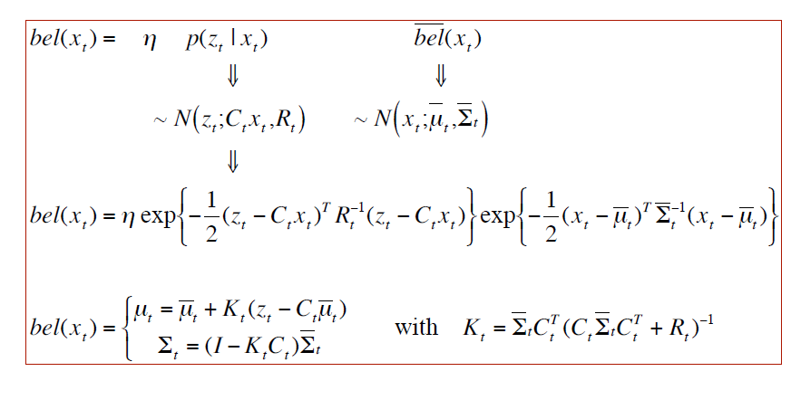
Linear Gaussian Systems: Observations

Slide 26
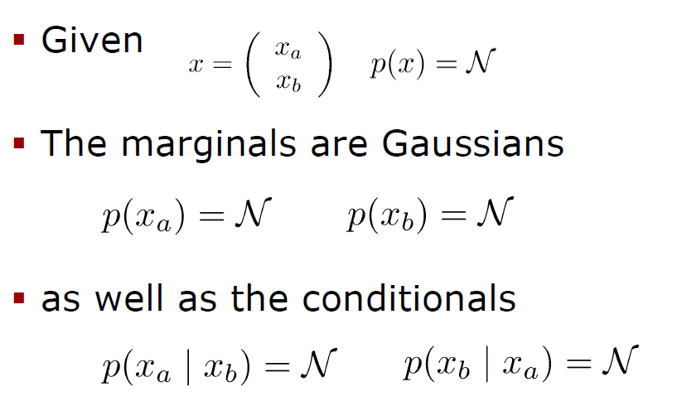
Properties: Marginalization and Conditioning
Notation for Gaussians
All are Gaussian

Slide 27
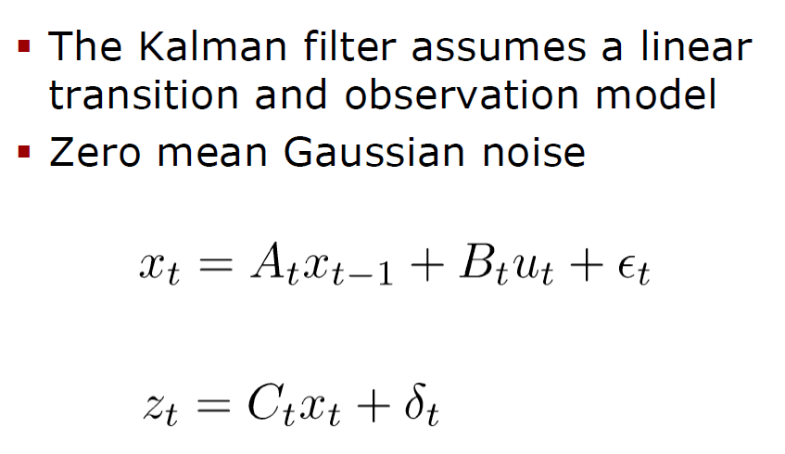
Kalman Filter assumes linearity
Zero-mean Gaussian Noise

Slide 28
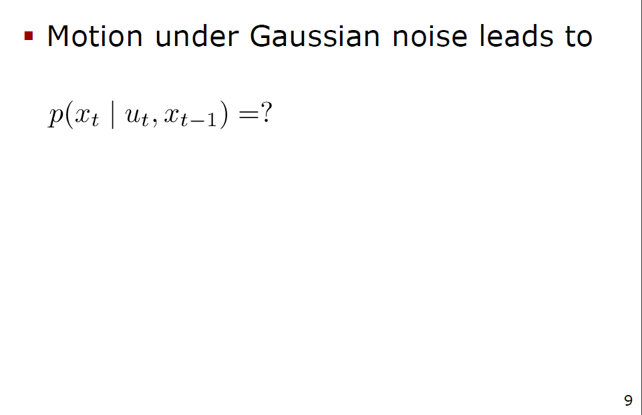
Linear Motion Model
We want to calculate this probability variable

Slide 29
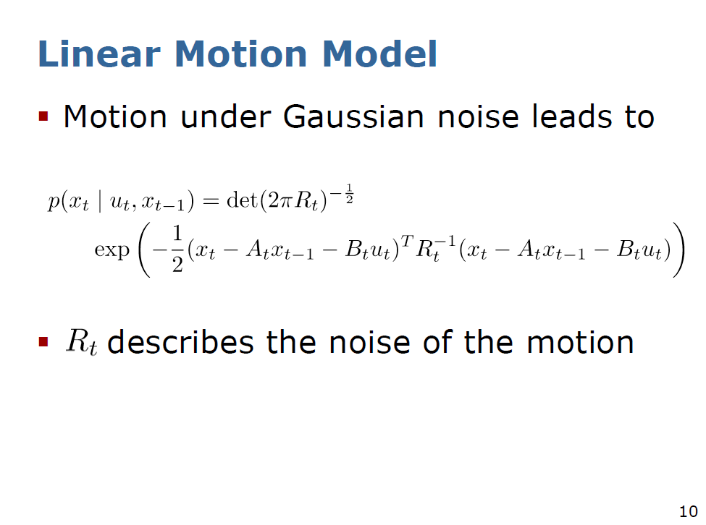
Theorem 1
We want to calculate this probability variable

Slide 30
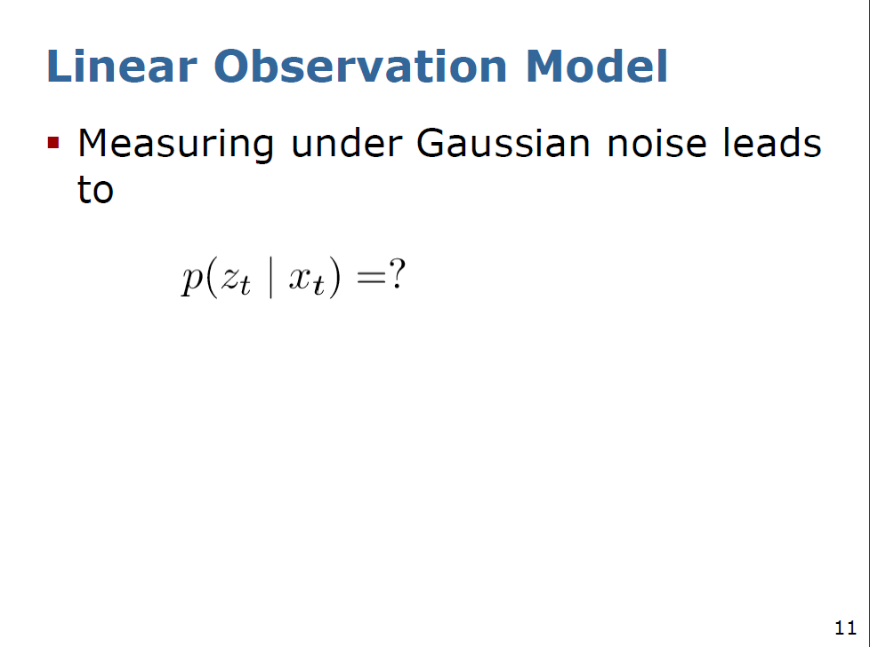
We want to calculate this probability variable

Slide 31
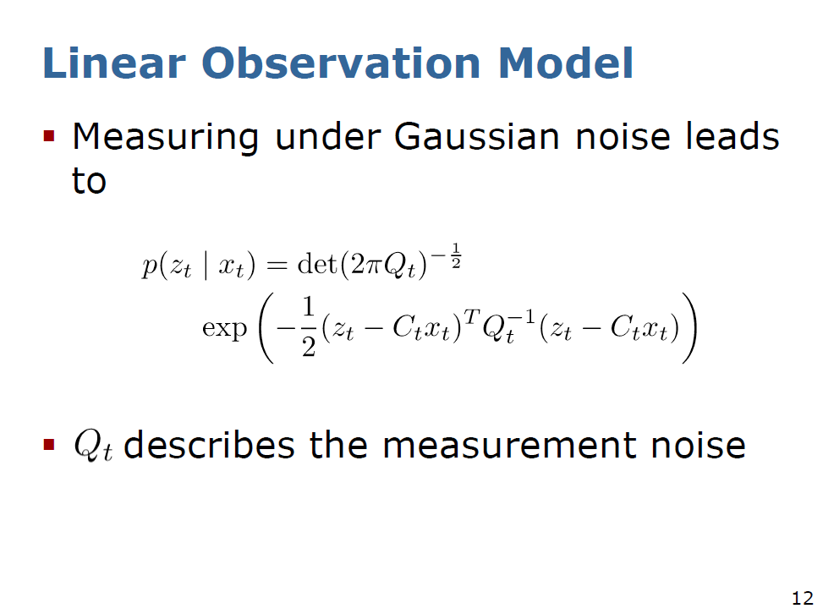
Theorem 2
We want to calculate this probability variable

Slide 32
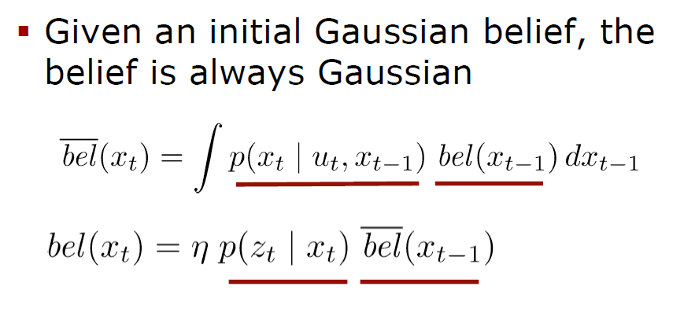
Everything stays Gaussian: the belief is Gaussian!
Theorem 3
Proofs of these theorems and properties are not trivial and can be found in the book by ‘three Germans” called Probabilistic Robotics.

Slide 33
Kalman Filter Algorithm

Slide 34
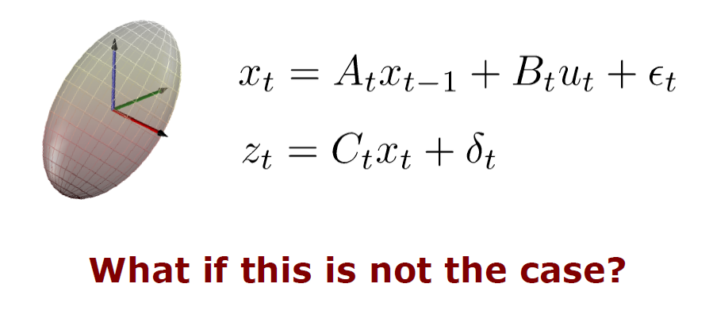
The Kalman Filter Assumptions are:
Gaussian distributions
Gaussian noise
Linear motion
Linear observation model
Discuss later

Slide 35
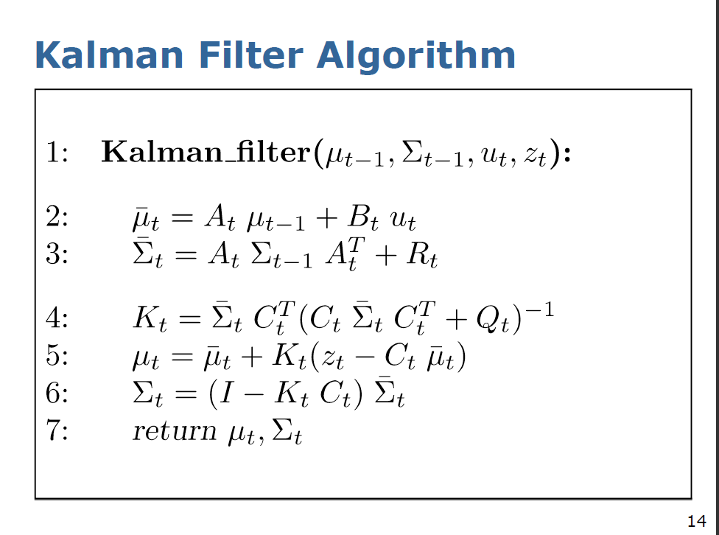
Calculates multi-dimensional mean and covariance matrix
Prediction of multi-dimensional mean
Prediction of multi-dimensional covariance matrix
Prediction phase
R for motion
Correction phase
Q for measurement
Calculates corrected multi-dimensional mean and covariance matrix
Kalman

Slide 36
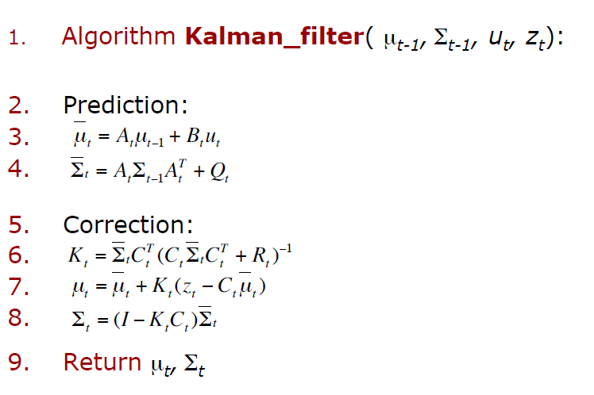
Kalman Filter Algorithm
Different notation to previous slide
Measurement noise

Slide 37
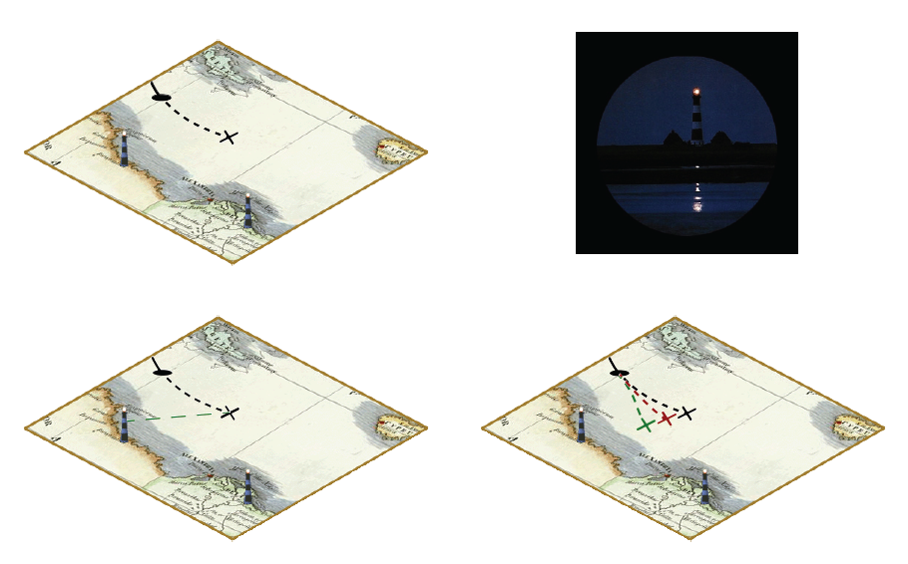
Kalman Filter Algorithm: navigation using odometry and measurement to landmark
Predicted and corrected position of the ship

Slide 38
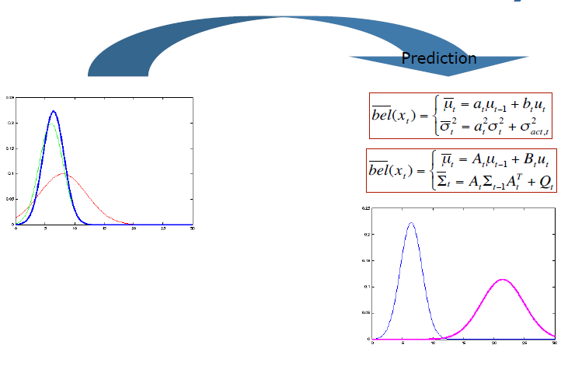
The Prediction-Correction-Cycle
The phase of Prediction

Slide 39
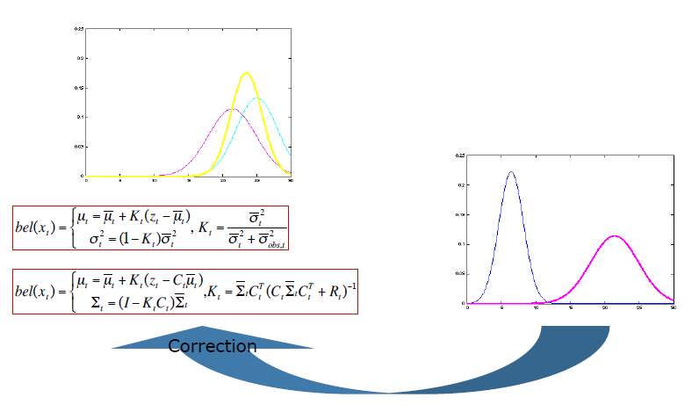
The Prediction-Correction-Cycle
The phase of Correction

Slide 40
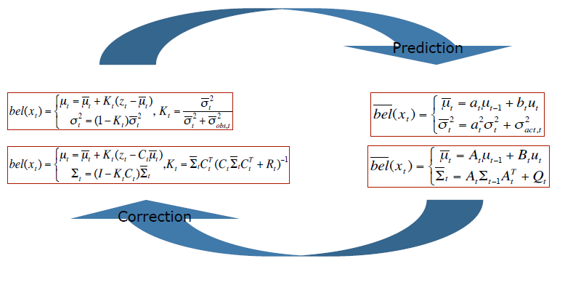
The Prediction-Correction-Cycle

Slide 41
The general
Optimal State
Estimation
Problem

Slide 42
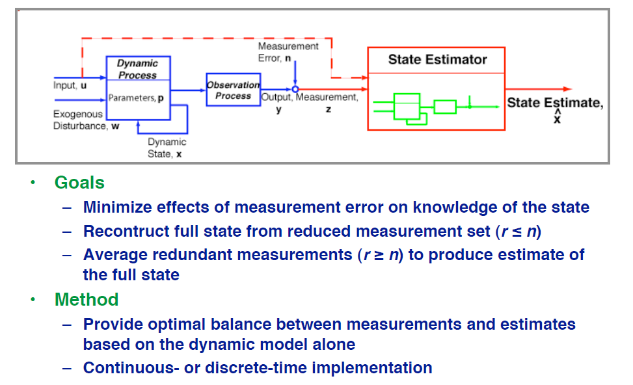
Diagram of general State Estimation
123
2 or 3 !

Slide 43
Discrete Kalman Filter
This is what we discussed

Slide 44
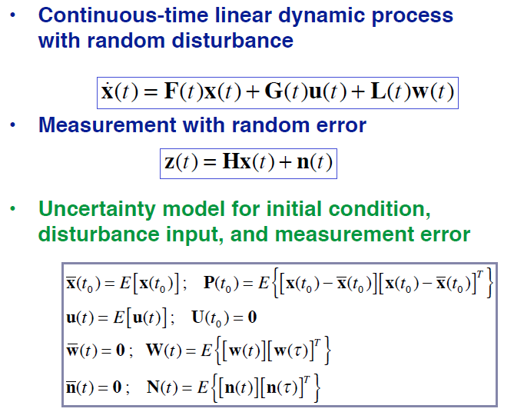
Linear-Optimal State Estimation
Change with time
derivative
Compare with this

Slide 45
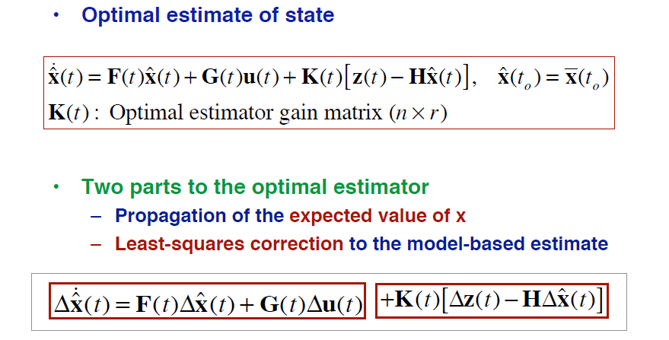
Linear-Optimal State Estimation (Kalman-Bucy Filter)
Similar to before
Kalman

Slide 46
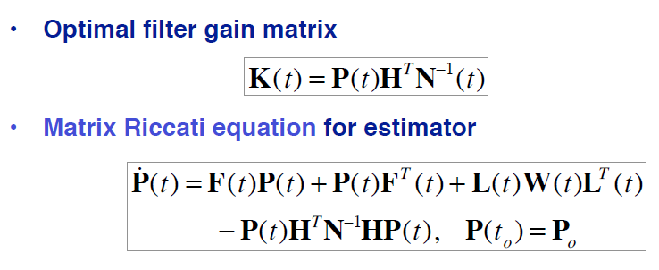
Estimation Gain for the Kalman-Bucy Filter
Same equations as those that define control gain, except
  solution matrix, P, propagated forward in time
  Matrices and matrix sequences are different
Notes:
Define LQ control gain

Slide 47
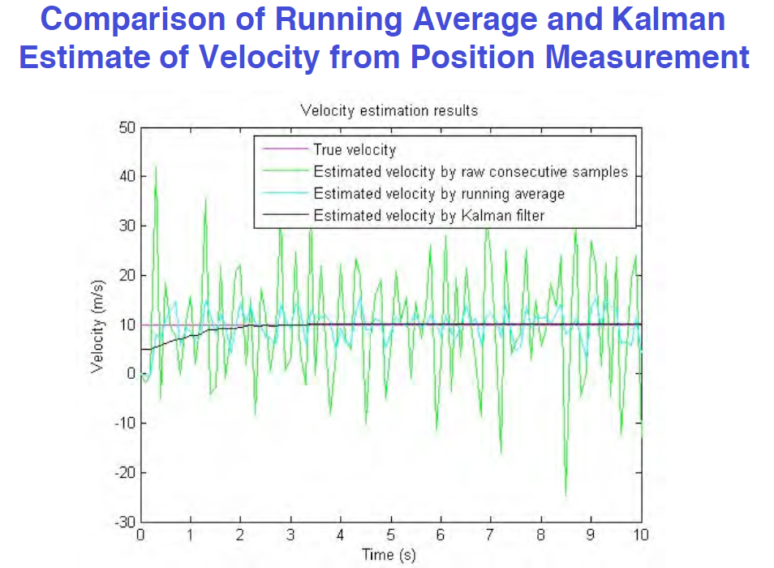

Slide 48
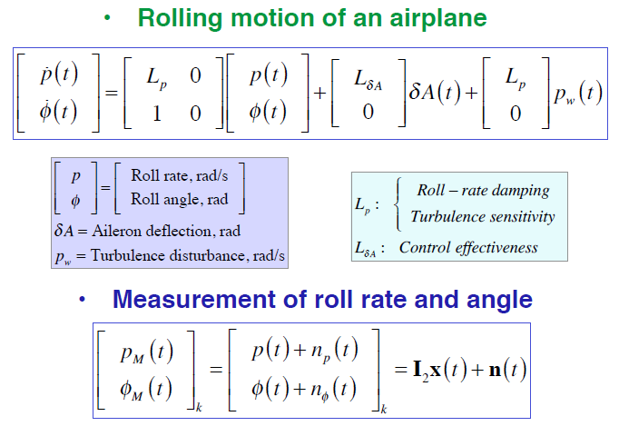
Second-Order Example of Kalman-Bucy Filter

Slide 49
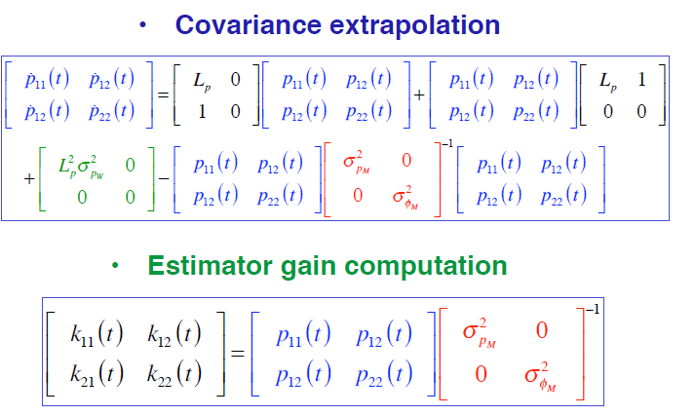
Second-Order Example of Kalman-Bucy Filter

Slide 50
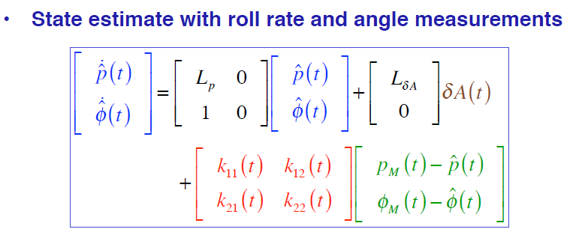
Kalman-Bucy Filter with Two Measurements

Slide 51
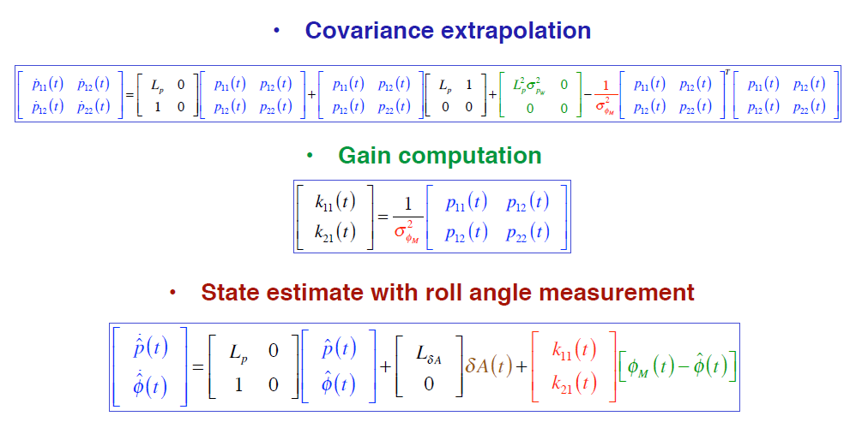
State Estimate with Angle Measurement Only

Slide 52
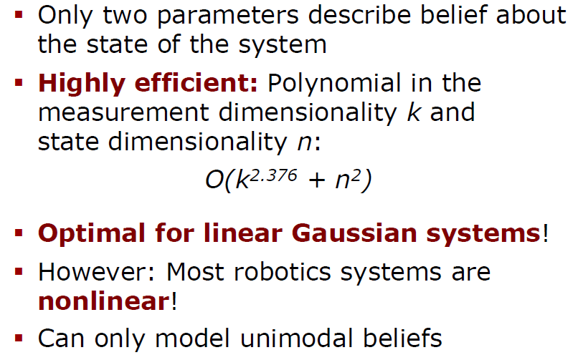
Kalman Filter Summary

Slide 53
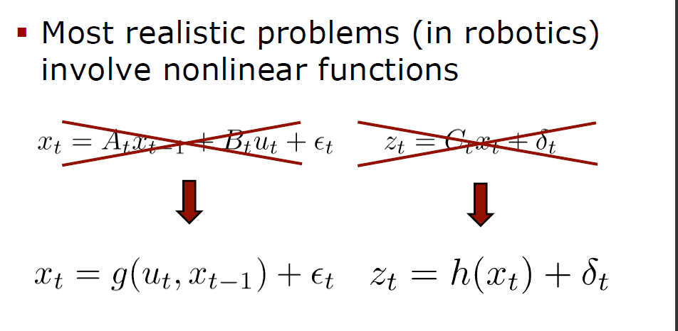
Non-Linear Dynamic Systems

Slide 54
Sources
Wolfram Burgard
Cyrill Stachniss,
Maren Bennewitz
Kal Arras

